Slide 1
Genetic Improvement CHORDS GROUP Stirling University
John Woodward
Saemundur Haraldsson

Slide 2
Overview
Motivations
Examples
Gen-o-fix (time series)
HashCodes for Hadoop
Evolutionary Computation
Automatic Design vs. GI
Conclusions

Slide 3
Motivation for GI
Aim is not to build programs from scratch.
Instead the aim is to take an already existing system and improve it (typically small changes).
This is done by operating on
source code (text file)
bytecode (executable file)
model of the code (e.g. GP function set)
abstract syntax trees
Biological Analogies (genetic modification, transplant)
Improve Functional/non-functional properties.

Slide 4
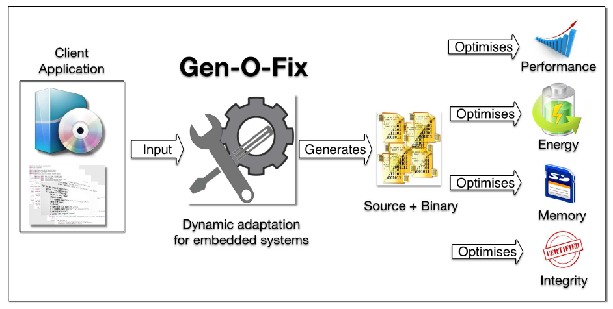
System Diagram for Gen-O-Fix

Slide 5
Gen-O-Fix: Abstract Syntax Trees
Main features of framework are
1. Embedded adaptively.
2. Minimal end-user requirements.
Initial source code: location of Scala source code file containing a function
Fitness function: providing a means of evaluating the quality of system
3. Source to source transformations
4. Operates on ASTs (i.e. arbitrarily fine).

Slide 6
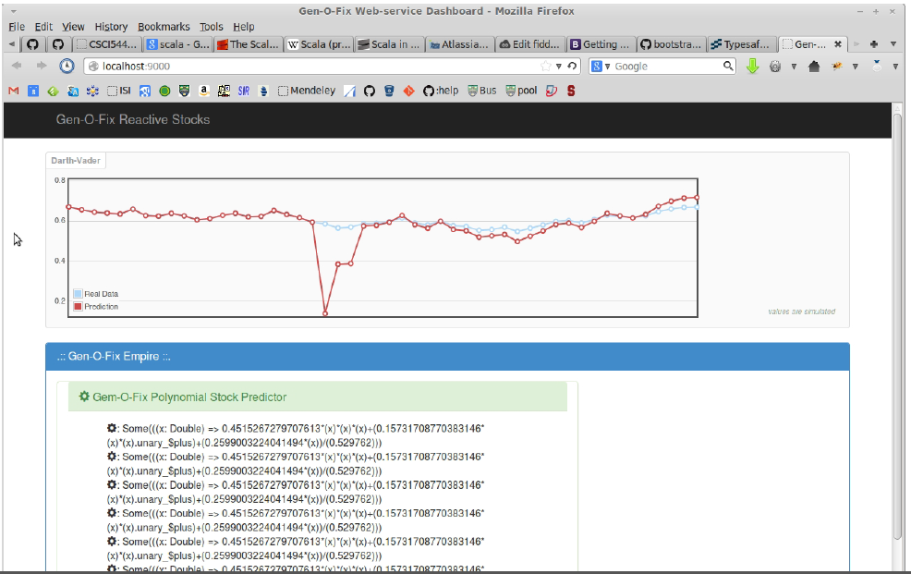
Gen-O-Fix output

Slide 7
GI Hadoop Hashcode
Hadoop provides a mapReduce implementation in Java.
Equals method has to obey contract (Reflective, Symmetric, Transitive, …)
x.equals(y) implies hashCode(x)== hashCode(y).
hashCode method is an integer function of a subset of an object's fields

Slide 8
Some GP Settings
Terminal set is
Field values
Random integers [0, 100]
Function set is
{+, *, XOR, AND}
Fitness function: close to uniform distribution (uniform distribution is the ideal), over 10,000 instances.

Slide 9
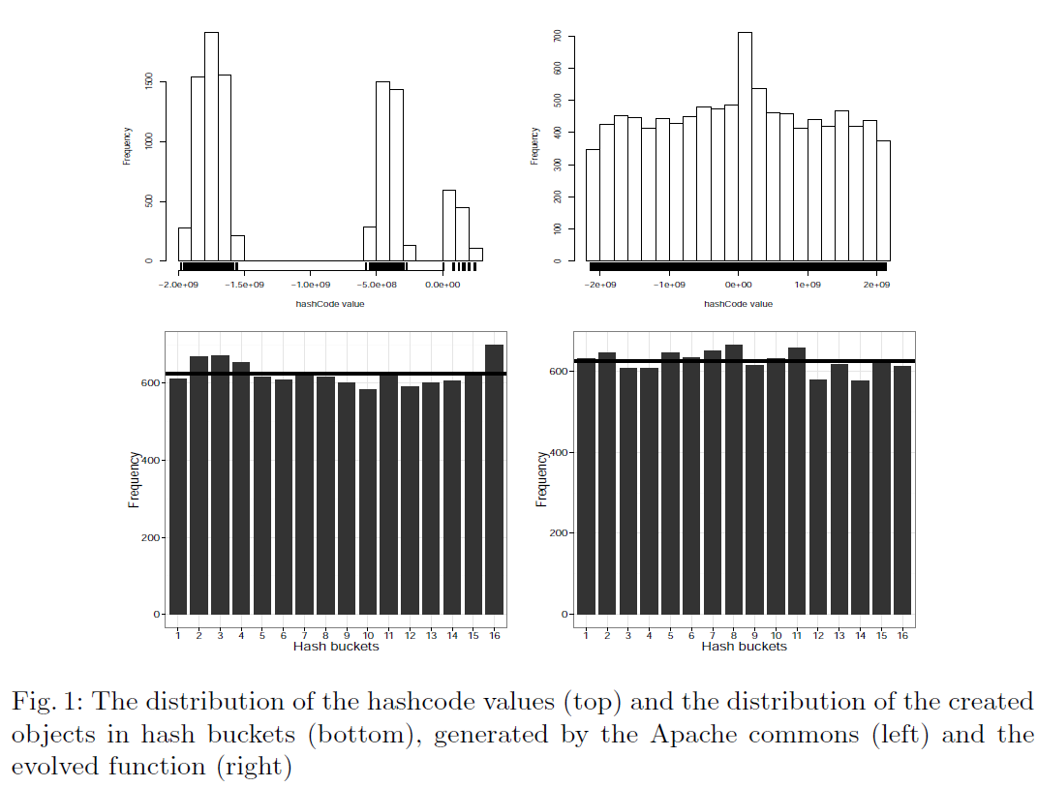
Distribution of Hashcodes

Slide 10
Case Study 1
public int hashCode() {
return layoutVersion ^ namespaceID ^
(int)(cTime ^ mostRecentCheckpointTxId ^ curSegmentTxId)
^ clusterID.hashCode() ^ blockpoolID.hashCode();}
public int hashCode() {
int a = (int)curSegmentTxId;
int b = (int)mostRecentCheckpointTxId;
return (a ^ (26 * (26 * (b & a))));
}

Slide 11
Case Study 2
public int hashCode() {
return this.sequenceNumber;}
public int hashCode() {
int a = renewer.hashCode();
int b = realUser.hashCode();
int c = owner.hashCode();
return (a ^ b) ^ (30 * (c * (a + b)));}

Slide 12
Case Study 3
public int hashCode() {
return new HashCodeBuilder().append(file).append(size).append(type)
.toHashCode();}
public int HashCode() {
int a = file.hashCode();
int b = (int)size;
int c = type.hashCode();
return (71 * (a + (43 * (b + c))));}

Slide 13
Improving Evolutionary Programming
Evolutionary Programming has a mutation operator at its core providing variation.
Many variations of this have been proposed manually by different researchers.
Mutation is therefore a suitable candidate for GI.
On a standard set of benchmark problem classes novel mutation operators are automatically designed which outperform human designed ones.

Slide 14
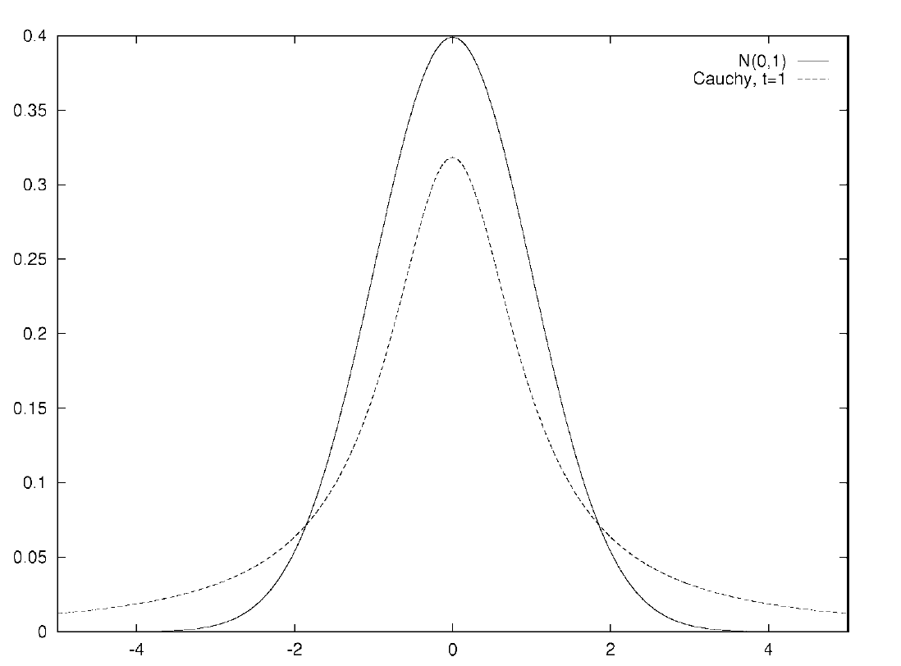
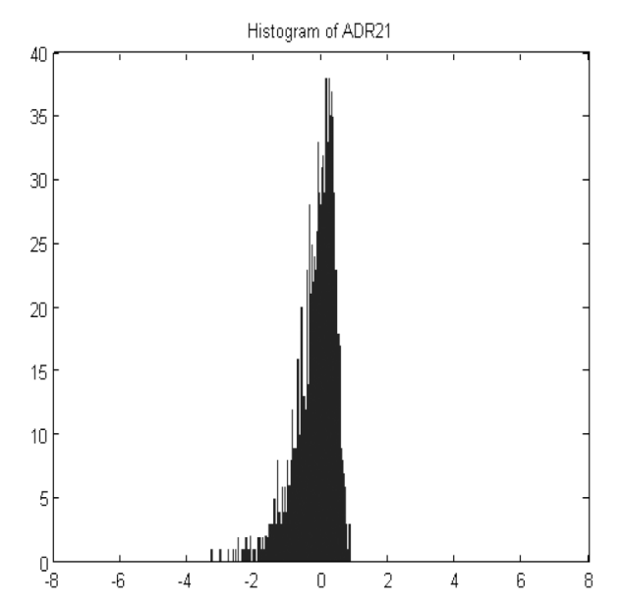
Gaussian, Cauchy and GI
Typically manually designed distributions used are symmetric and with mean of zero (Levy family). (above right)
Automatically designed are free of these constraints. (below right, sample 3000)

Slide 15
Comparing GI with Automatic Design of Algorithms
Three techniques operate directly on programs (source code, executable code, abstract syntax trees). In situ (software is its own substrate).
Automatic Design operates on a Genetic Programming Function Set. In vitro (a model of the software)

Slide 16
Genetic Improvement (GI) and Automatic Design of Algorithms (ADA)
ADA and GI both produce human competitive programs
ADA and GI both typically apply evolutionary computation methods to generate changes.
GI can produce syntactically incorrect and nonterminating programs while ADA generates syntactically correct terminating code.
ADA is always to improve functional properties while GI's focus has largely been non-functional properties.
GI is more general (applied to any software), ADA has it typically used for heuristics and machine learning and data mining algorithms.

Slide 17
Activity & Profile
GECCO 2014 workshop on Automatic Design of Algorithms (including GI).
PPSN 2014 tutorial (mentioning GI)
One PhD student working on GI
Possible project with KLM.
Agilent Grant (Jerry Swan)
'Spark' data analysis + ML framework, including: “framework configuration, query optimization, data placement and memory usage.

Slide 18
Conclusions
Modifications to programs are typically much smaller than the original program.
Notion of problem classes.
A population of “edits/changes” is maintained not populations of programs.
Pre-analysis allows one to target parts of the program for modification.
GI is a superset of numerical parameter tuning
GI and ADA are highly related.

